Slide 1

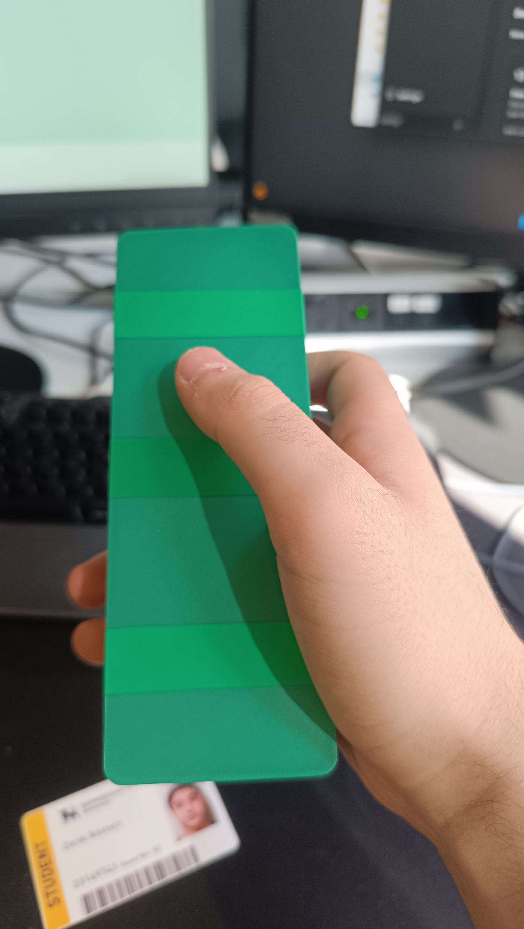
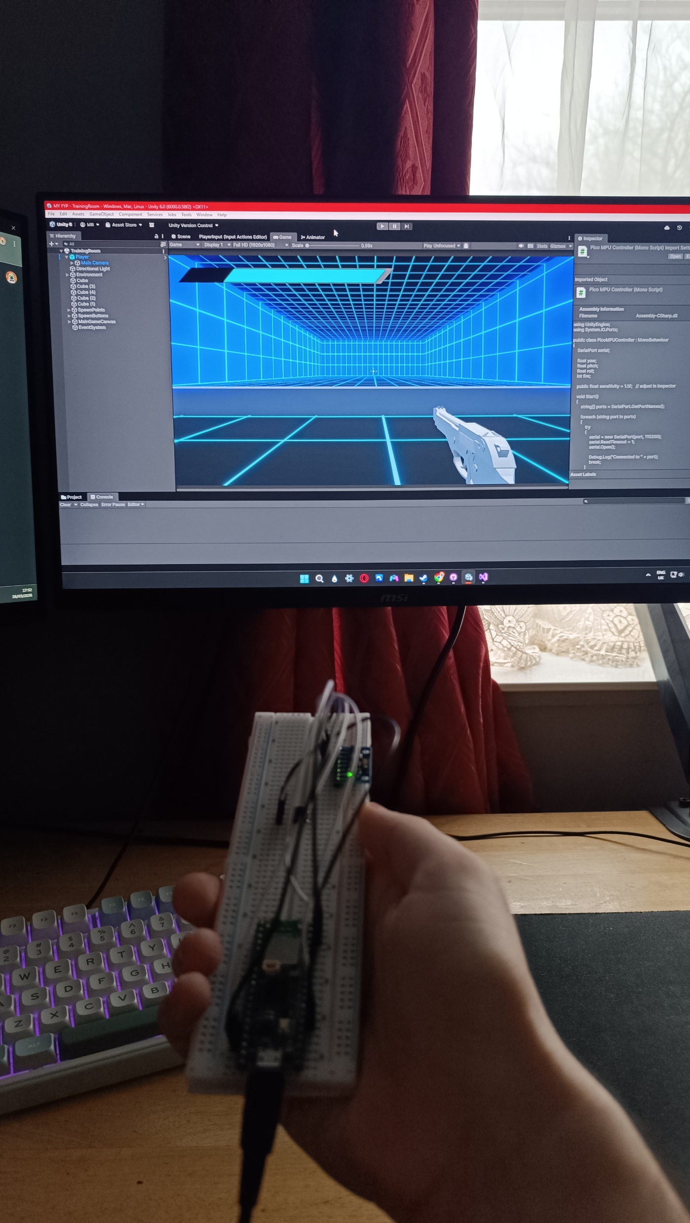
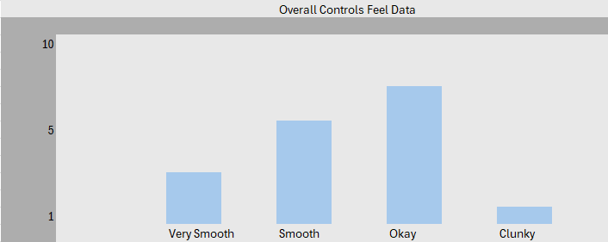
PROJECT TITLE
Student Name | Supervisor | Course
Explores alternative game controllers.
How it helps shape player immersion, experience and accessibility
Motion-Based Controller for the study
Problem Statement:
Expensive Controllers
Not all Controllers Cater to everyone.
Limited accessibility creates barriers for many players.
Methods
Raspberry Pi Pico WH
MPU6050 (gyro/accelerometer)
Breadboard, jumperwires, buttons and 3D printed Case
Unity + C# + Thonny
Data Gathering (13 Testers)
Aims & Objectives:
Develop a motion-based controller and game to evaluate alternative controllers.
Low-cost system
Analyses usability, responsiveness and immersion and accessibility
Results
/Implementation & Testing / Evaluation
Tests took place where the users who consented and read the information sheet conducted in playtesting as well as taking part in an online form.
Discussion
Acknowledgements | GitHub | QR Code
Conclusion and Future Work
References
Acknowledgements | GitHub | QR Code

